Slide 1
Module 2 - Project
Northwind Database
Chris Gudde

Slide 2
Questions Being Evaluated
1 - "Do discounts have a statistically significant effect on the number of products customers order? If so, at what level(s) of discount?”
2 - "Does the holiday period (defined as November and December) have a statistically significant negative impact on the number of orders placed?”
3 – “Do lower priced items have statistically significant higher order volumes?”
4 – “Does mean order quantity vary by region by a statistically significant amount?”
5 – “Does increasing order quantity have a statistically significant correlation with increasing freight cost?”

Slide 3
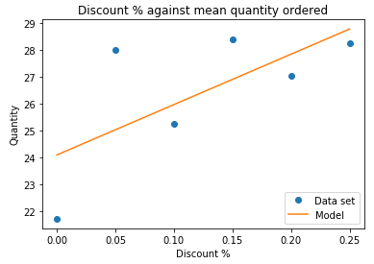
Question 1: "Do discounts have a statistically significant effect on the number of products customers order? If so, at what level(s) of discount?”
Conclusion:
There is a positive correlation between discount and order quantity.
Recommendation:
Discounting is an effective way of increasing order quantities, in the event of a business objective to increase sales quantity discounting would be an effective mechanism.
Further work:
Establish effect on profitability.

Slide 4
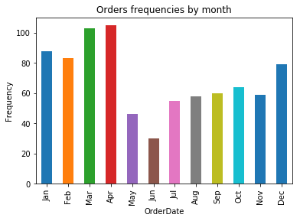
Question 2: "Does the holiday period (defined as November and December) have a statistically significant negative impact on the number of orders placed?”
Conclusion:
There is not a negative effect on the number of orders during the holiday season.
Recommendation:
If looking to stabilise demand there are other periods in the year which would have a greater effect than focusing on the holiday period.
Further work:
Establish driving factors of high and low order volumes.

Slide 5
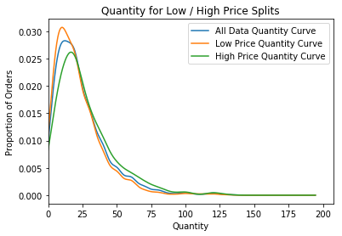
Question 3: “Do lower priced items have statistically significant higher order volumes?”
Conclusion:
There is a non-negligible correlation between decrease in item price and the increase in quantity ordered.
Recommendation:
In combination with work completed on discounting drive higher sales of high value goods with discounts.
Further work:
Increased detail in price breakdown beyond low/high

Slide 6
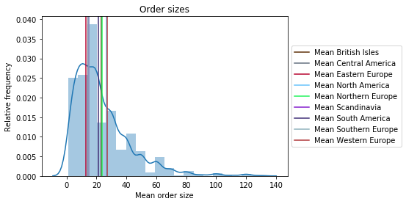
Question 4: “Does mean order quantity vary by region by a statistically significant amount?”
Conclusion:
There is a non-negligible variation in the mean order size from different regions.
Recommendation:
Potential targeted regional promotions to improve order size in regions with lower mean order sizes.
Further work:
Establish if there are particular products which have regional variations in demand.

Slide 7
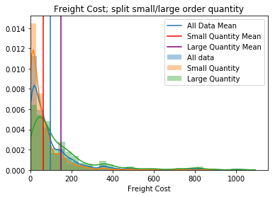
Question 5: “Does increasing order quantity have a statistically significant correlation with increasing freight cost?”
Conclusion:
There is a non-negligible correlation between increase in order quantity and the increase in freight price.
Recommendation:
Ensure that freight prices are proportionate, the current variance in price per item is high.
Further work:
Establish if the freight price is linked to the order value and/or region ; disproportionately high freight prices could disincentives customers.

